Slide 1


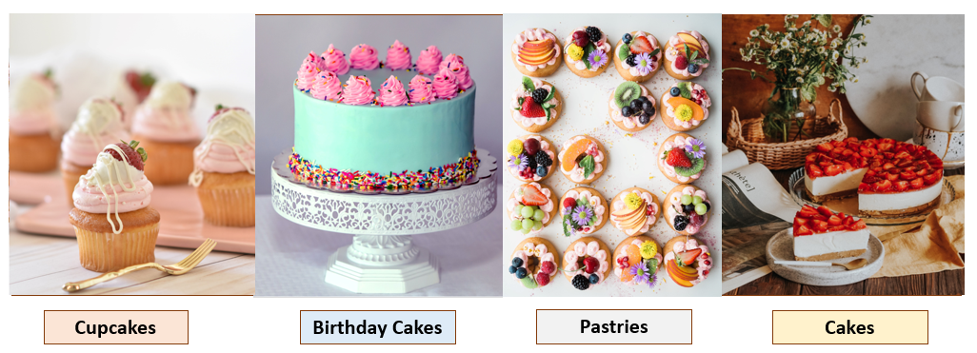
What Are You Looking For?
Weekend SALE! Weekend SALE! Weekend SALE!

Slide 2

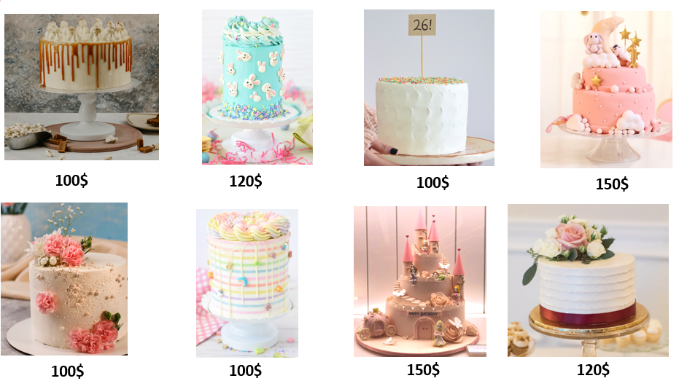
Birthday Cakes
5
5
3
4
5
4
4
4

Slide 3
Want To Be Our Friend?
And Get 10% discount Each Buy
Email Address:
Password:
Already Friends
Let’s Become Friends
Continue Without Becoming A Friend Right Now

Slide 4
New Friend
First name:
Last name:
Email Address:
My Location:
Birth Date:
Apply
Password:
Password Confirmation:

Slide 5

Your Shopping Cart
Your Item:
Amount:
1
Friendship Discount:
10%
Check Shipping Cost
Shipping Cost:
10$
Total Cost:
110$
Rate :
1
2
3
4
5

Slide 6

Shipping Cost
Ship to:
Beer-Sheva
Shipping cost:
10$

Slide 7
Today’s Orders
Type | Amount
Birthday Cake 1 | 1
Birthday Cake 2 | 3
Birthday Cake 5 | 2
Piastres1 | 1
Piastres3 | 2
Cake7 | 6

